Slide 1


Pimp My Heinz
Extreme Customization
A Usability and User Experience project

Slide 2
Ethnographic Analysis
Segmentation and User Research have been the first necessary steps for the development of our project.
They are useful for determining what is the context, who is the target user and what are the needs the system has to address.

Slide 3
Segmentation & User Research
Introduction
Buying habits
Information about the product
Source of information
Frequency
Packaging
Type of product (new vs known)
Positive choice factors
Negative choice factors
Online purchasing
Segmentation
User Research
Interview
Quality, “indole”, price, longevity, environmental impact
young
computer-literate
quality and sustainability-seeking
moderately wealthy
status-oriented
creative
longing for uniqueness
User
Age, job, past experiences, tastes, opinions, ...
Survey

Slide 4
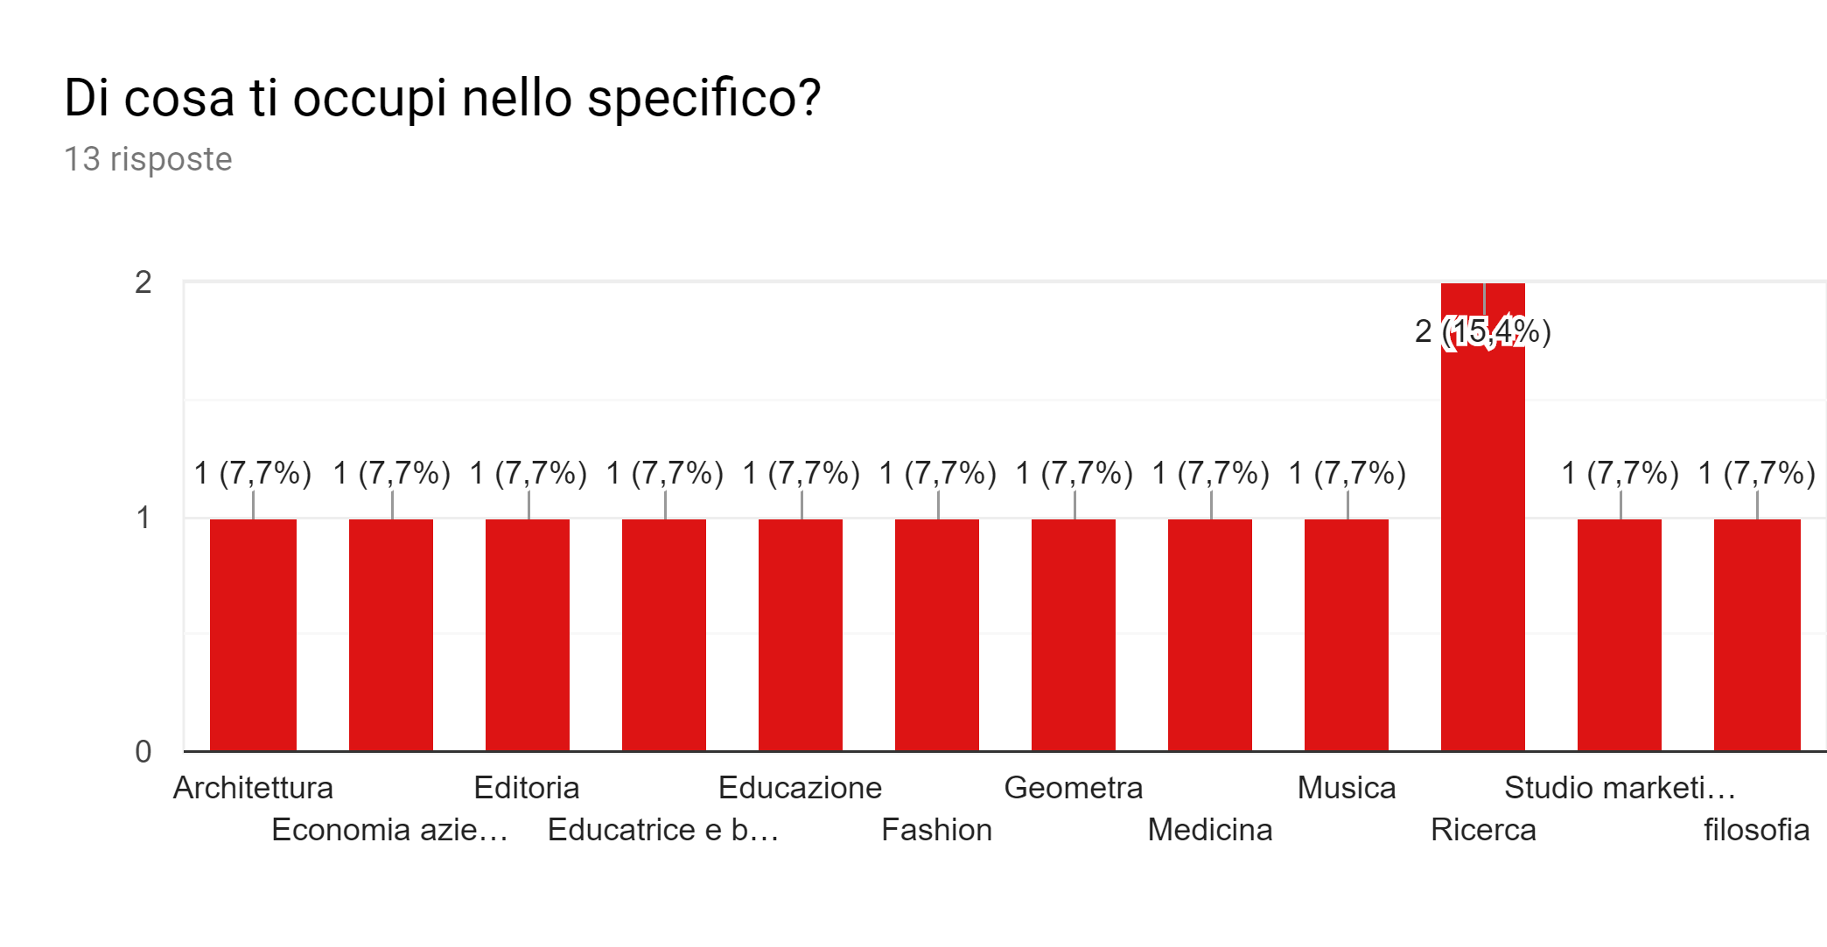
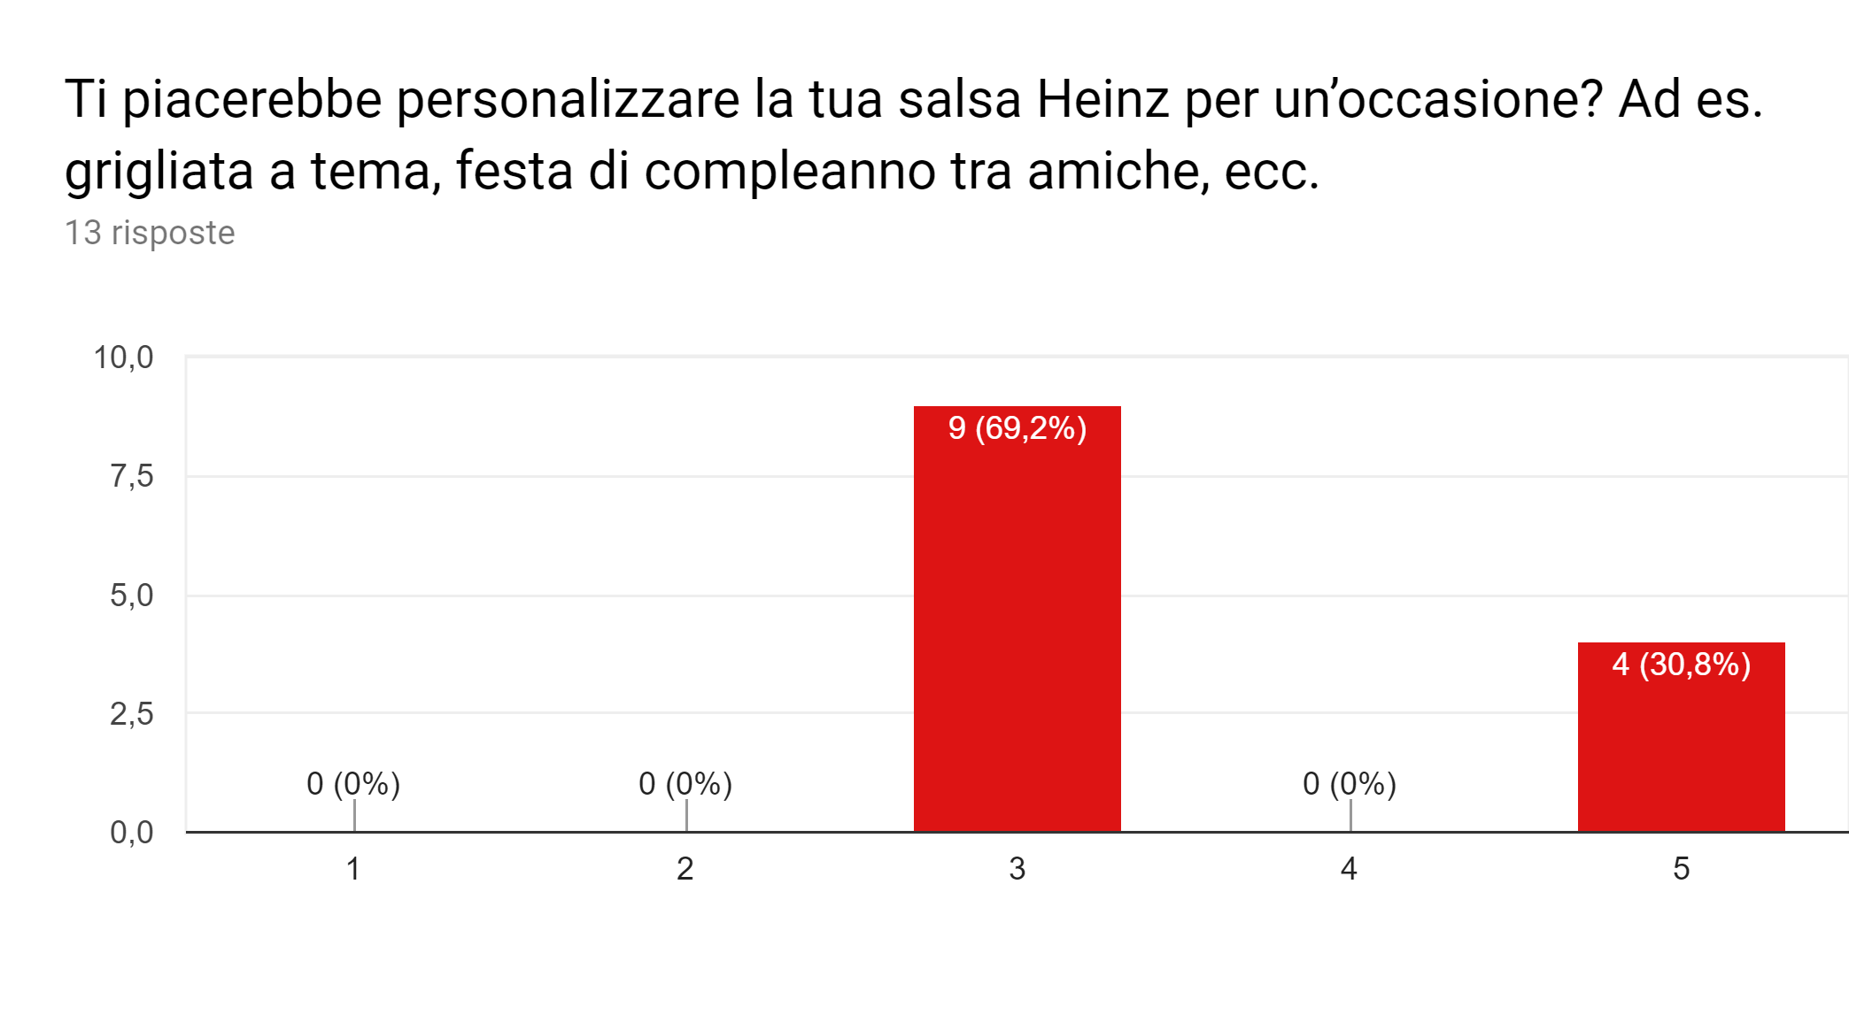
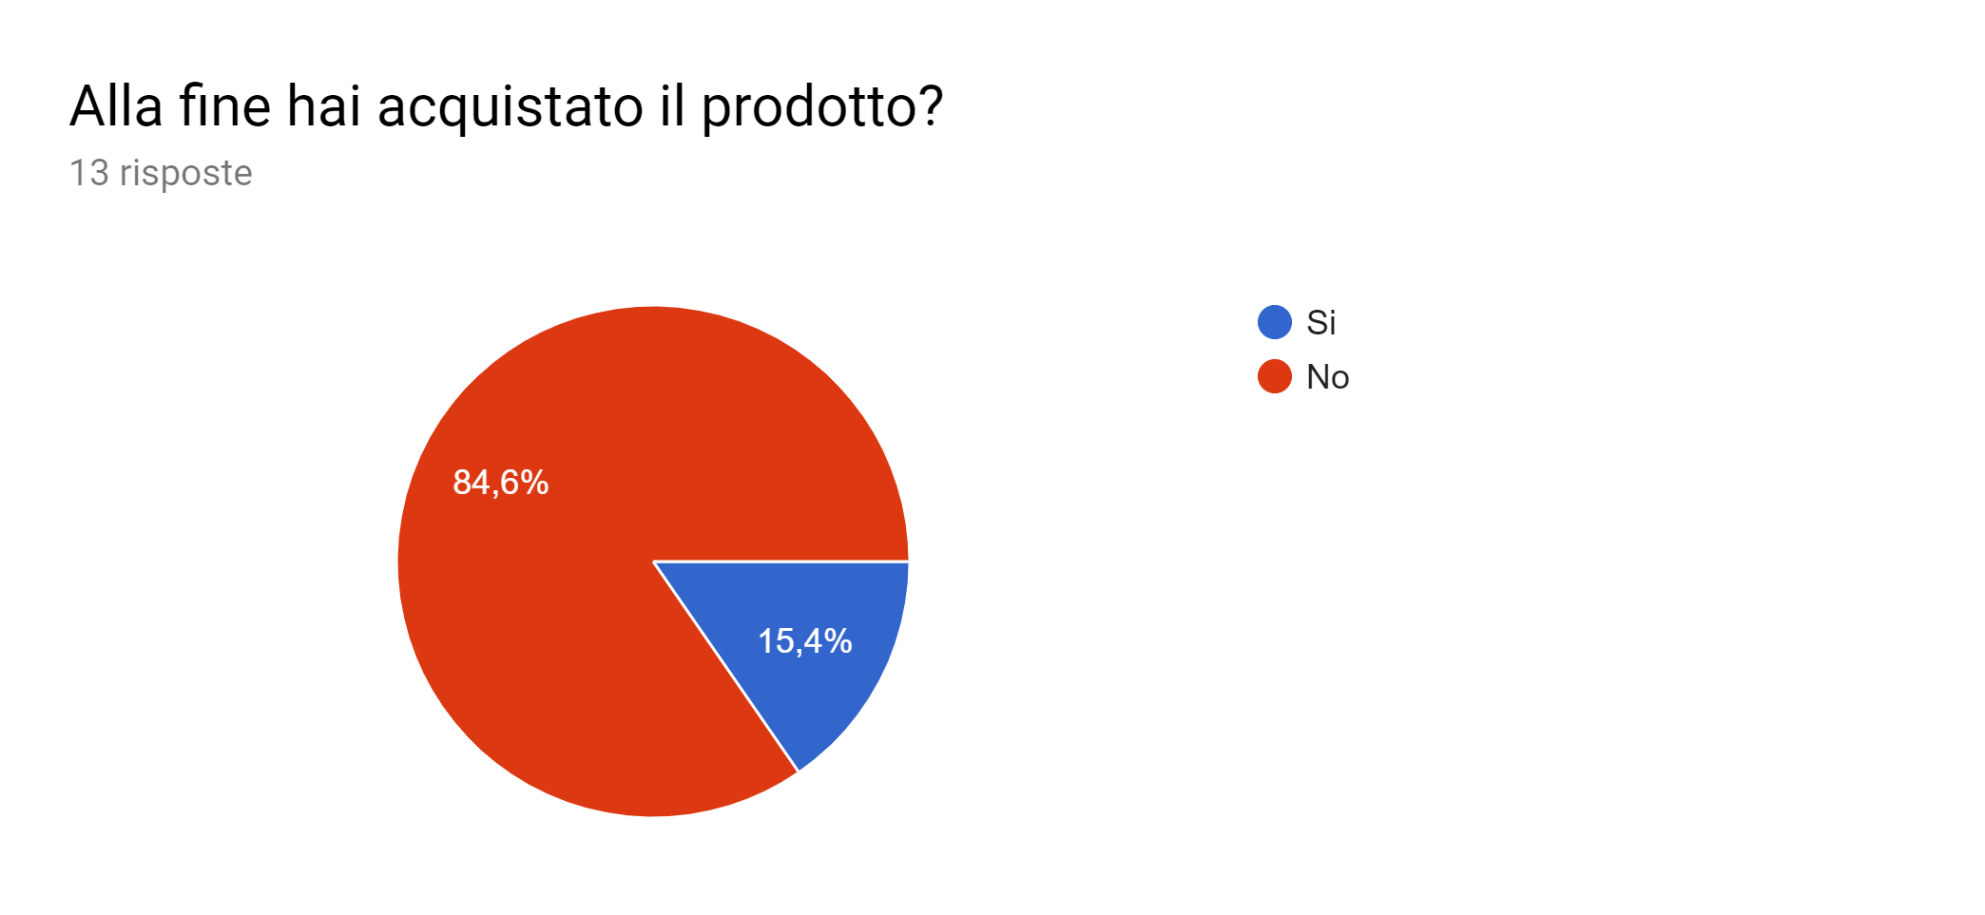
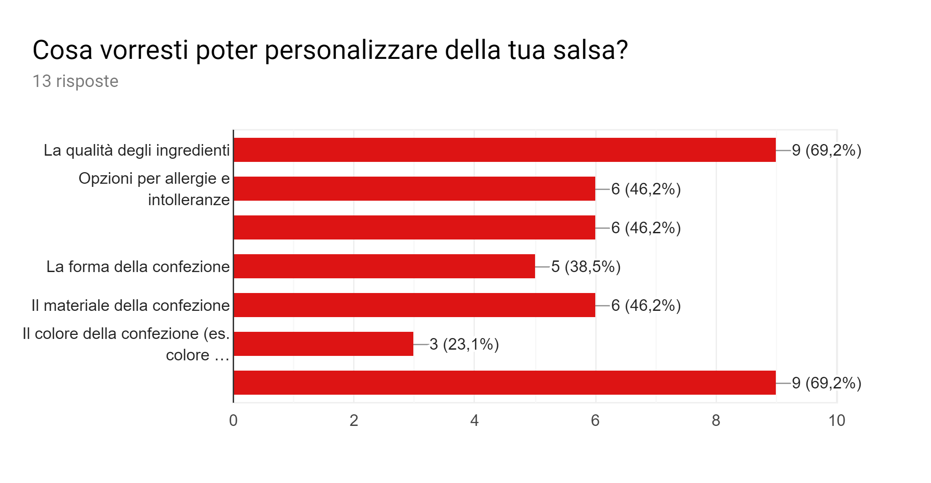
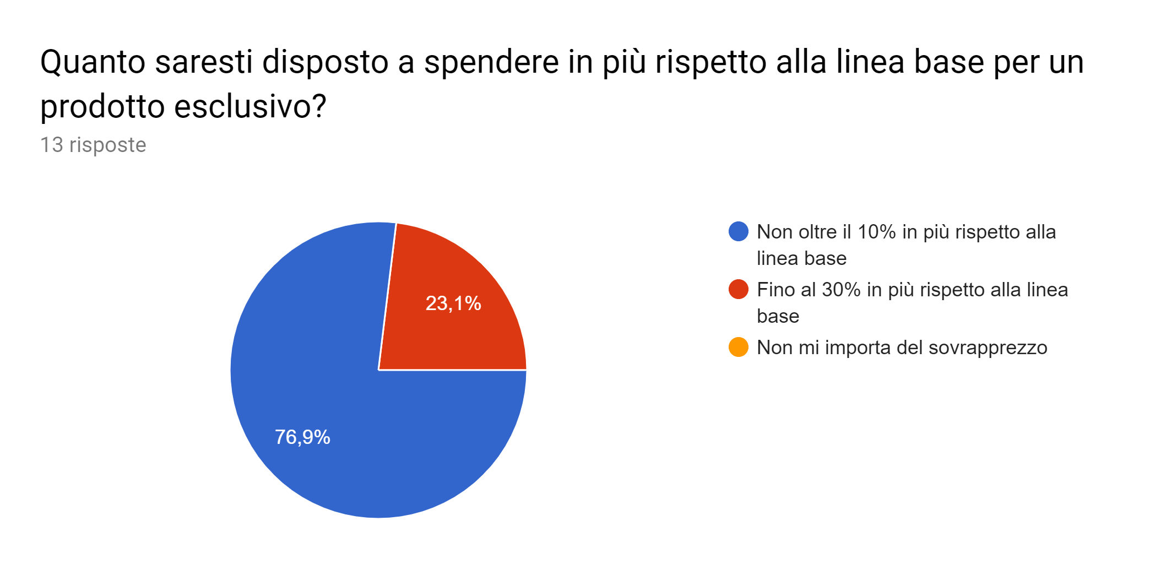
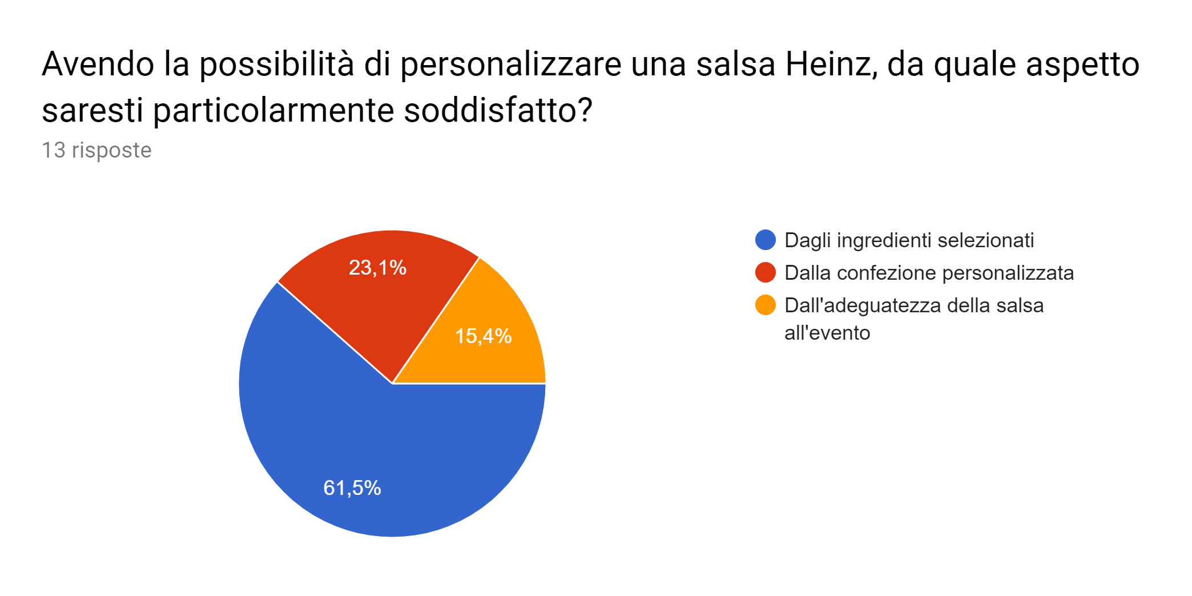
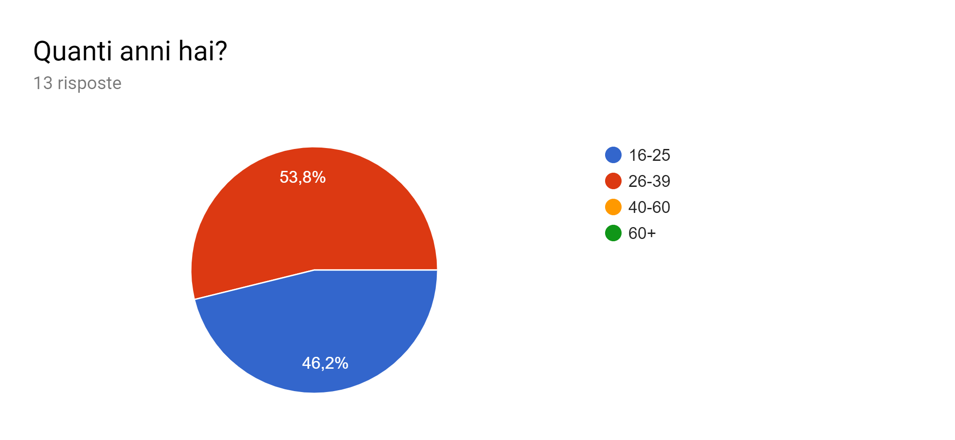
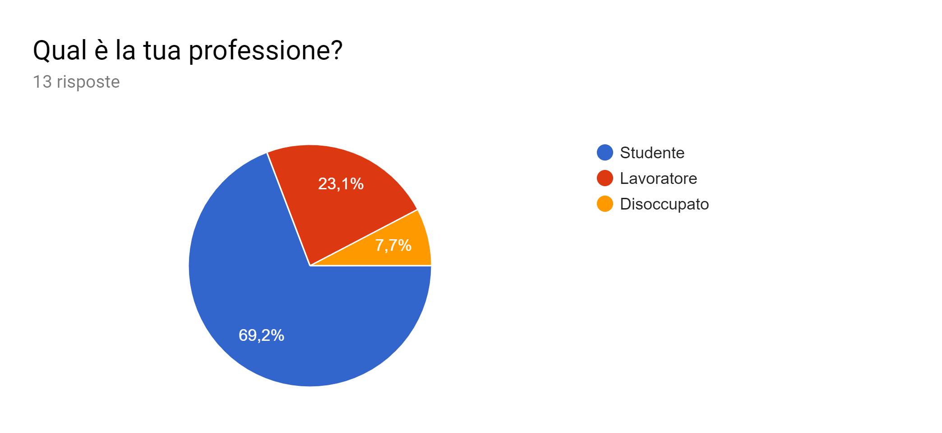
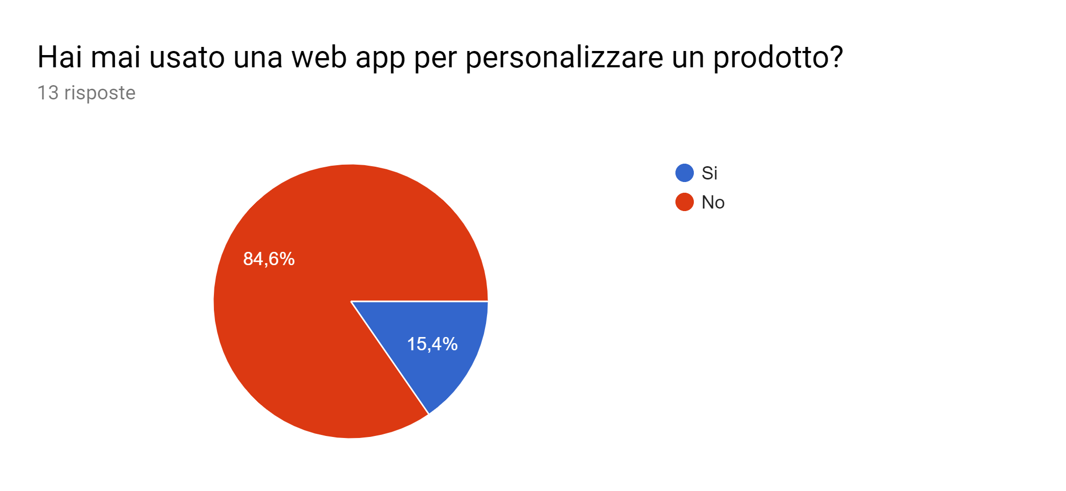
Survey results

Slide 5
Assessment of existing resources
Before designing the actual Extreme Customization ancillary site, it is necessary to assess both the existing site in which it will be embedded and its possible competitors.
Expert Usability Review and User Testing, complex and highly structured procedures, are the fundamental steps to do so.

Slide 6
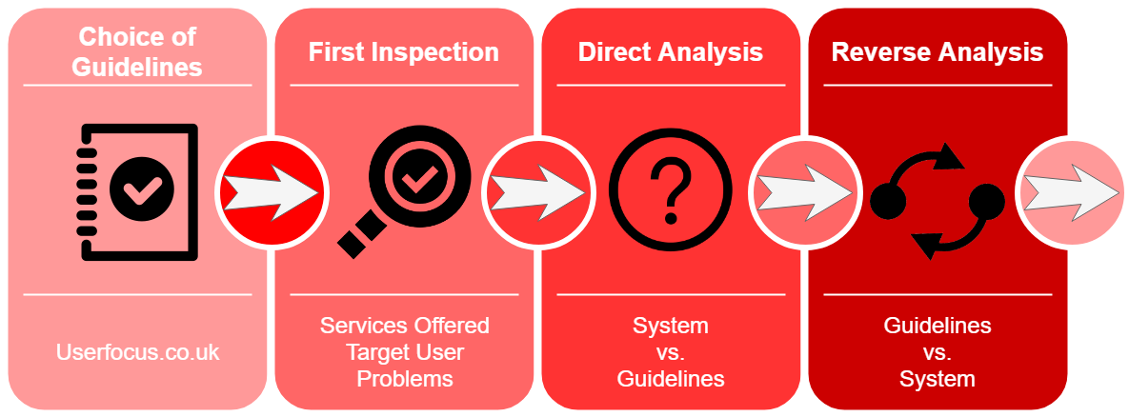
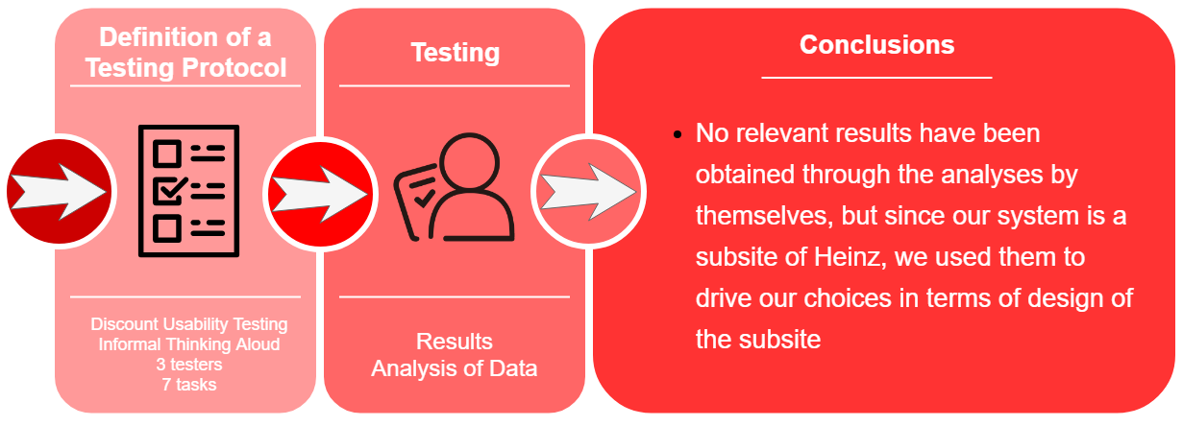
Expert Usability Review & User Testing: Heinz

Slide 7
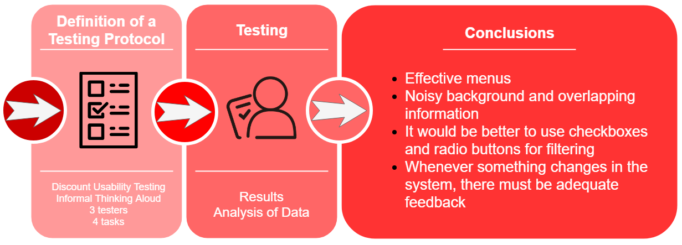
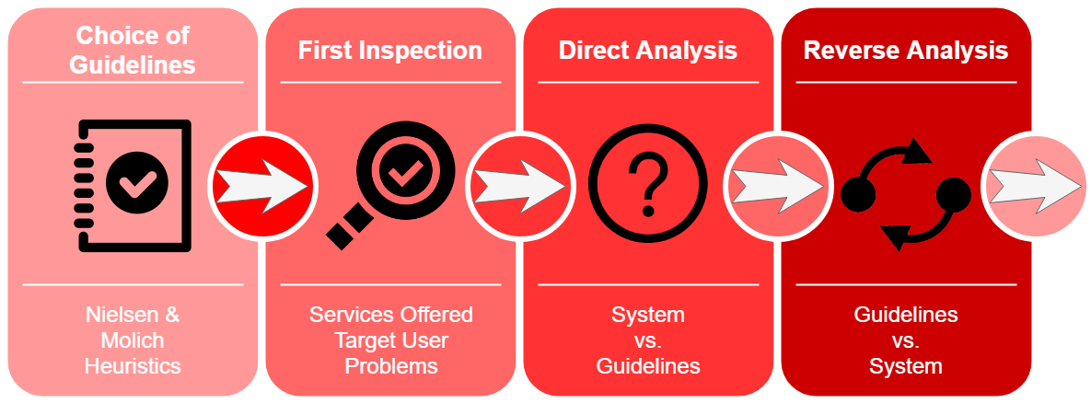
Expert Usability Review & User Testing: CustomHeats
Visibility of system status
Match between system and real world
User control and freedom
Consistency and standards
Error prevention
Recognition and recall
Flexibility and efficiency of use
Aesthetic and minimalist design
Help users recognize, diagnose and recover from errors
Help and documentation

Slide 8
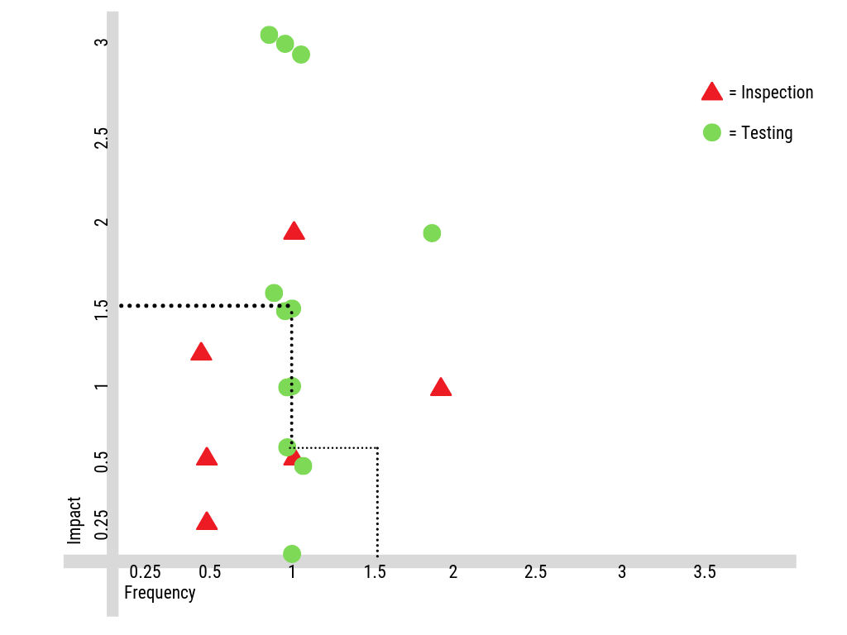
Urgency Curve
To errors detected in the inspection phase and in the testing were assigned scores from 1-3.
To separate cosmetic and minor errors from serious and catastrophic ones, a 1.5 threshold was set.
Errors above the resultant curve should be fixed immediately.

Slide 9
Feasibility Study
Before designing the actual Extreme Customization service, it is also necessary to determine whether such service is realistically feasible or not.
Determining the Context of Use and creating Scenarios and Personas allow the development of a solid foundation that any Usability project needs in order to be valid.

Slide 10
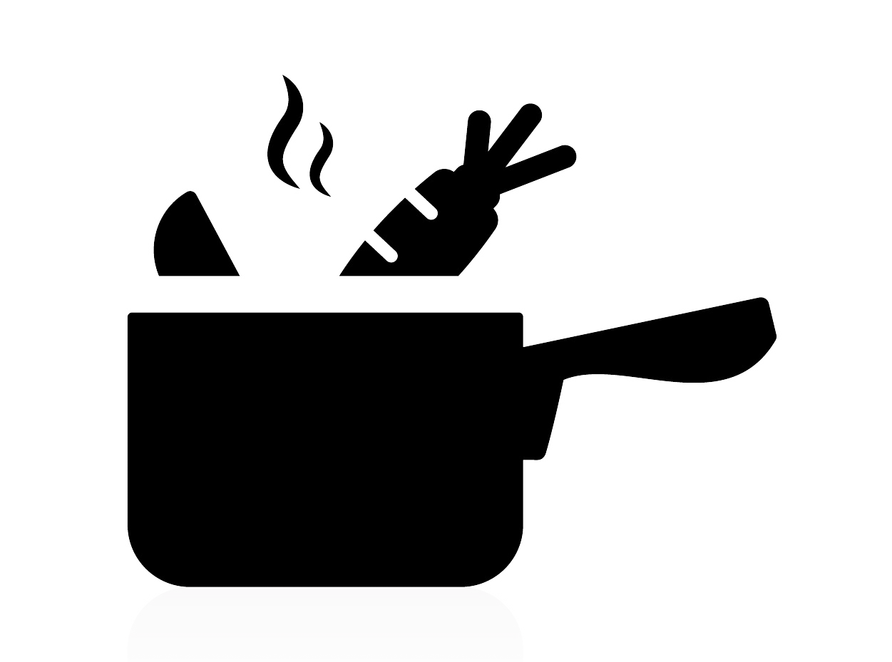




Context of Use
Extreme
Customization
Sauce
choose your own ingredients, their quantity, the overall density and many other qualities of the sauce!
Package
choose the material and the size of the bottle you prefer - fight waste!
choose the template and colors that best fit your tastes!
Label

Slide 11




Scenarios
The housewarming party
A man wants to give a customized sauce to a friend as a gift for his housewarming party. His friend is vegan and aware of the environment. He has very specific and interesting tastes, so a customized service may come in handy...
The food blogger
A food-blogger wants to review the application, so he uses the service to customize some sauces and starts planning the set design for a shooting to integrate in the next post for his blog...
The worker
A woman on her way from work decides to try out the application, having her attention drawn by the recreational aspect of the application in order to pass some time...
The couple
A young couple is organising a barbecue next to the house’s pool. Their focus is on healthy and tasty products that both adults and kids may like...

Slide 12

Scenarios (2)
The pub
A local businessman owns a bar, which is famous for its happy hour among young people of the city. Additionally, there is also a waitress working in the shop. While leading the small activity, the owner and the waitress are really busy. They thought about creating their own sauce, but they have no time to prepare it for the everyday happy hour. Surfing on the Internet, the waitress found “Pimp my Heinz” and especially liked the possibility to customize package and label of the sauce. She told about her idea to her boss: a personalised sauce in terms of flavour, package and label may give to their business an extra touch. The owner is very pleased about the idea, also considering that Heinz is a trustworthy, worldwide company focused on product quality.

Slide 13
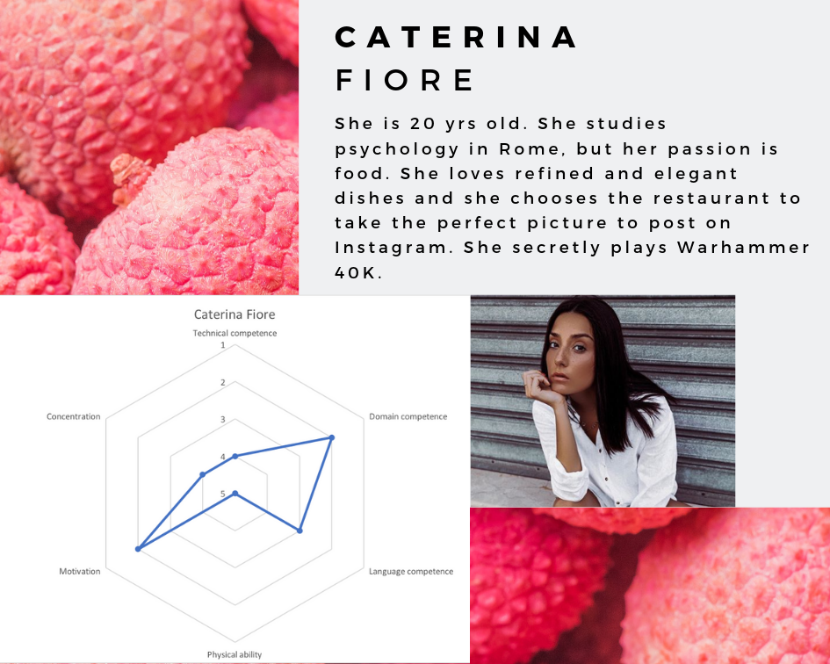
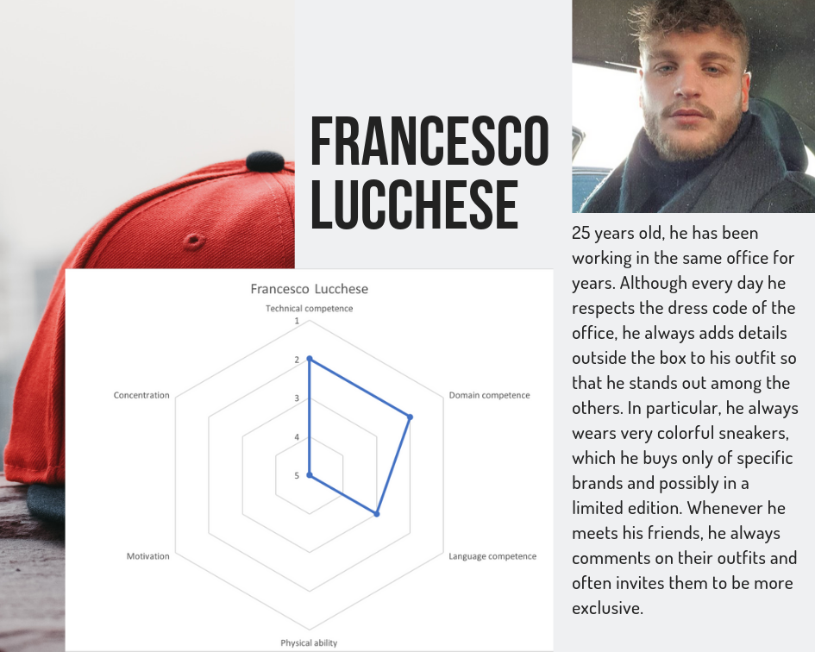
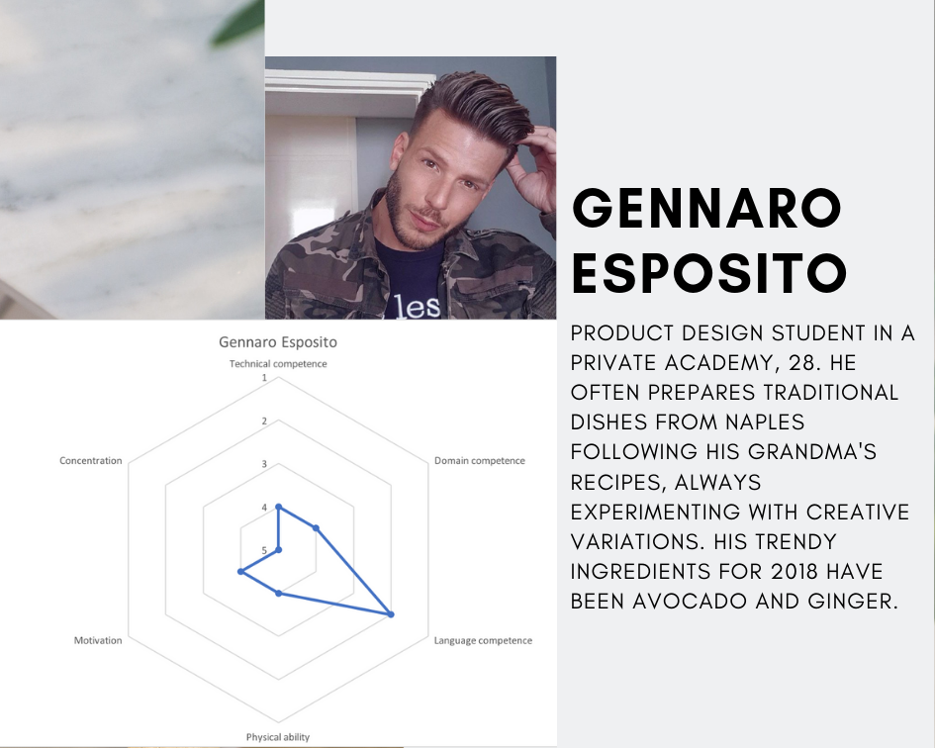
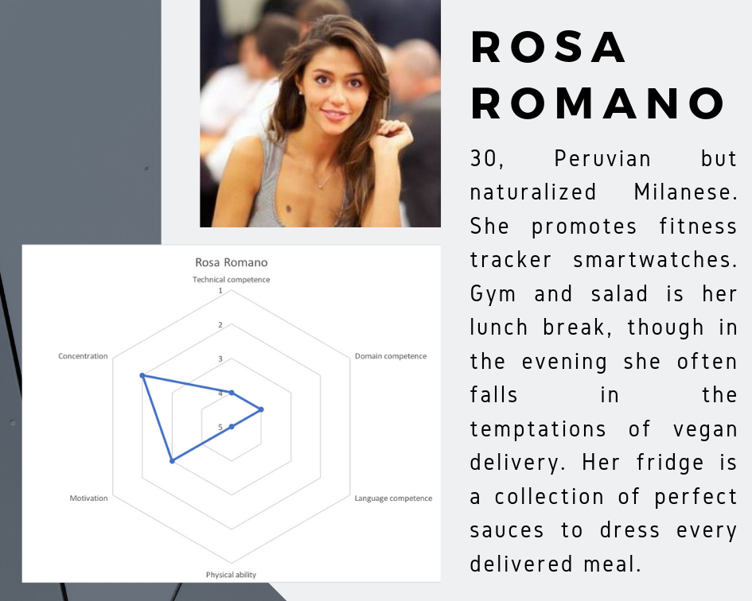
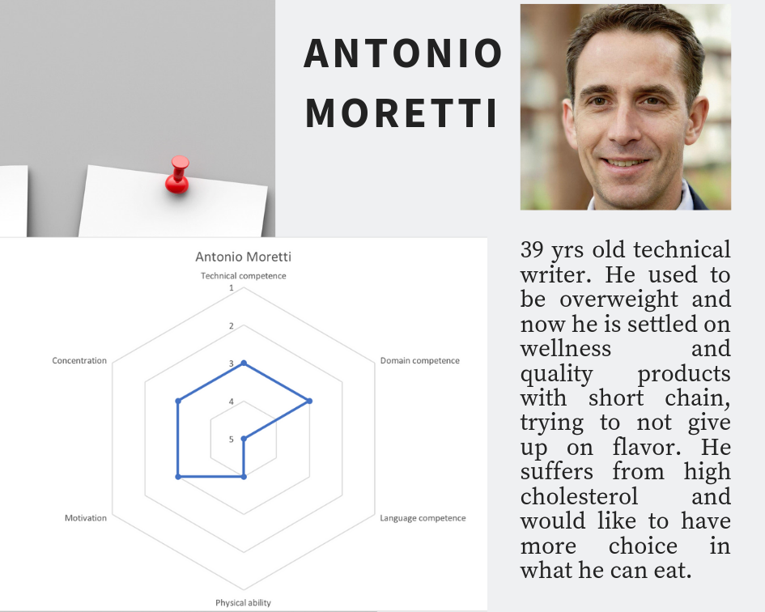
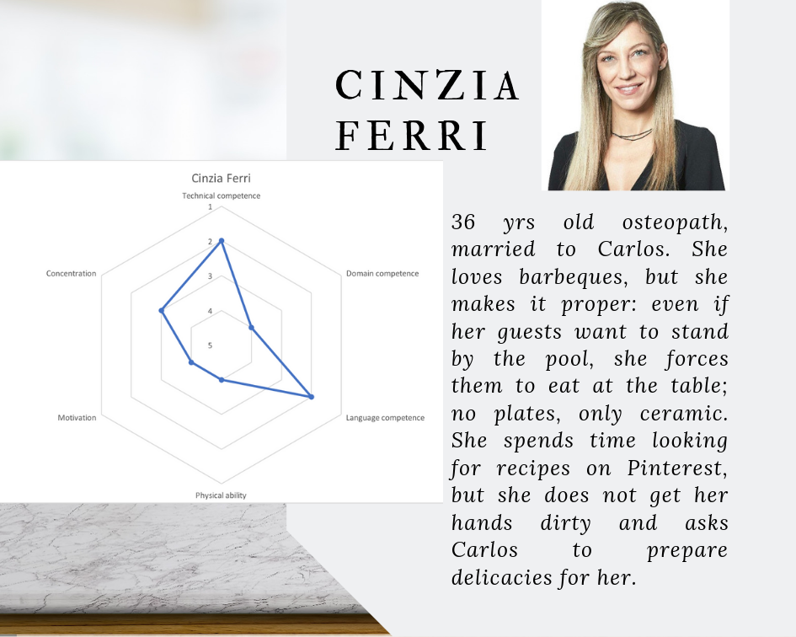
Personas

Slide 14
Design Proposal
Designing an Extreme Customization service is a long and complex process. It starts by drafting an Information Architecture and representing it through a Blueprint. Then, the paradigm known as CAO=S model is applied, before the development of the system’s Interaction Design, represented through a series of Wireframes.

Slide 15
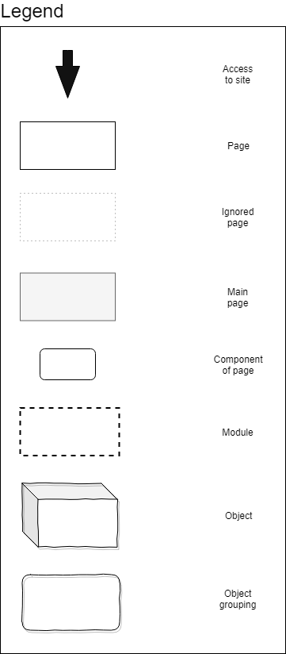
Information Architecture & Blueprint
top-down approach
participatory process
Customization module is the core of the system and its most complex part

Slide 16
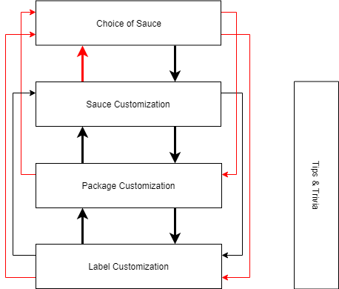
Information Architecture & Blueprint (2)
The black arrows indicate the possible interactions between sub-modules before the pilot test done in Section 5.
The red arrows indicate the other additional interactions between sub-modules after the pilot test done in Section 5.

Slide 17
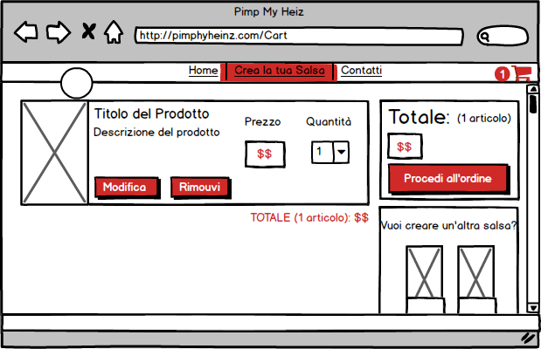
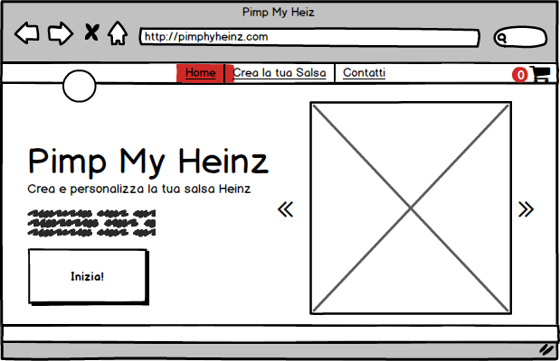
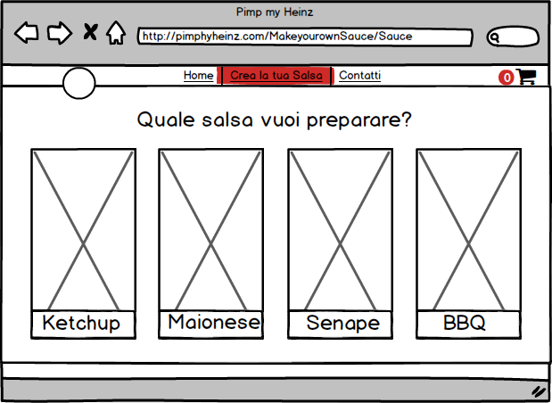
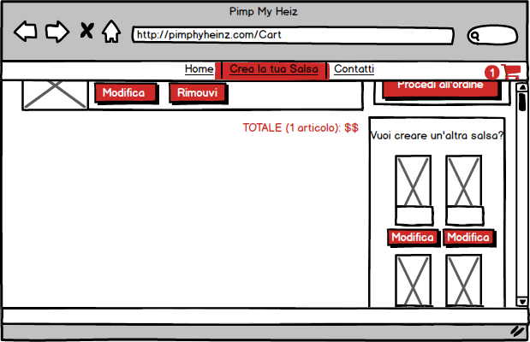
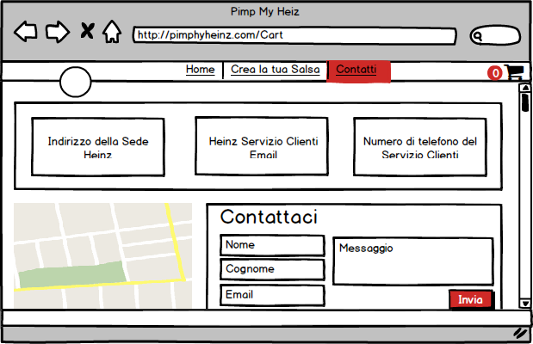
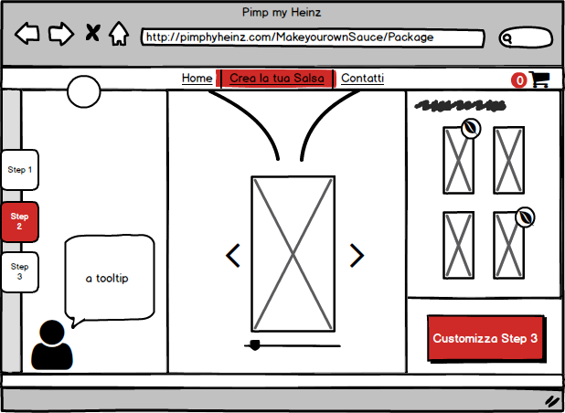
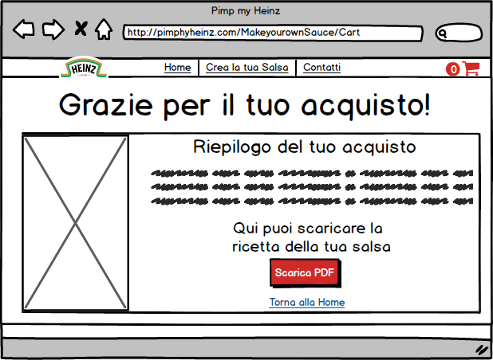
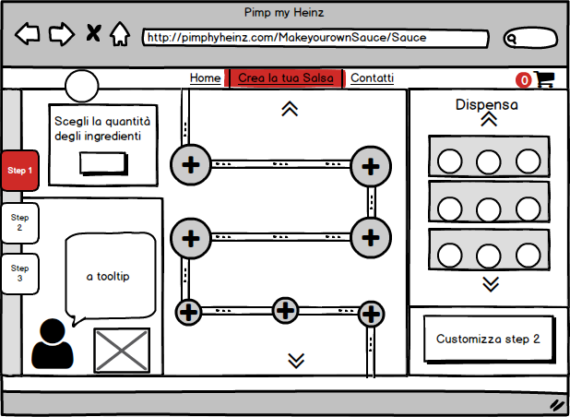
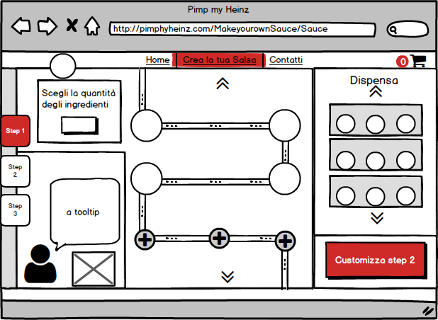
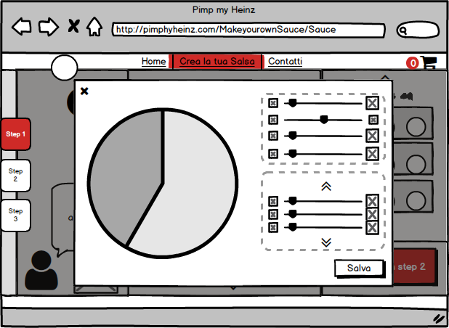
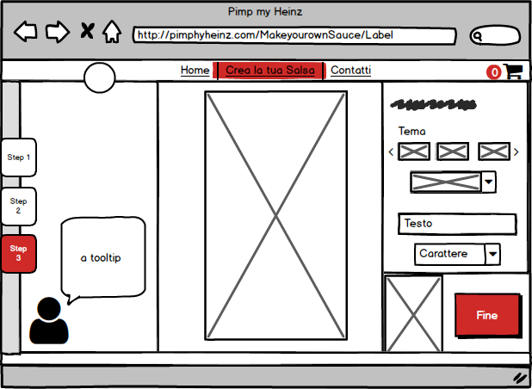
Interaction Design & Wireframes

Slide 18
Evaluation of Design
Once a coherent prototype has been designed, it is necessary to evaluate its usability. As with the Assessment of Existing Resources, a first evaluation phase has been conducted by the development team; then, at a later time, a second evaluation phase has been conducted by some users with a low-budget user testing to test the system usability.

Slide 19
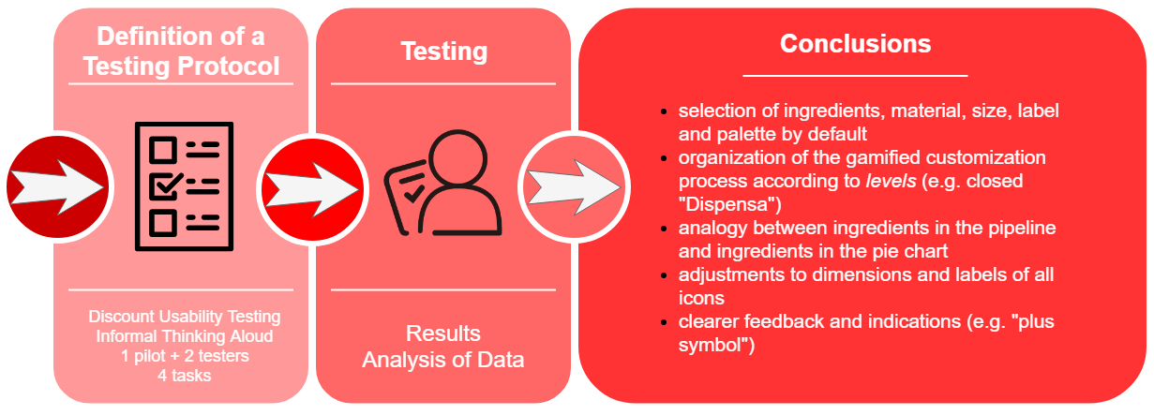
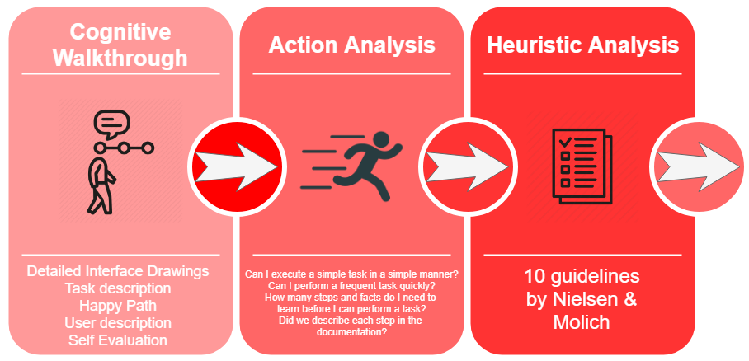
Inspection & User Testing: Pimp My Heinz
Go to the platform that allows you to customize the sauce.
Select the x mandatory ingredient.
Select the y optional ingredient.
Select the maximum quantity of the z ingredient.
Delete the ingredient a to replace it.
Select the b size bottle.
Select the c material for the bottle.
Select the d template for the label.
Write the text e on the bottle.
Select the f font for the inserted text.
Shift from the g edit section to h edit section.
Visibility of system status
Match between system and real world
User control and freedom
Consistency and standards
Error prevention
Recognition and recall
Flexibility and efficiency of use
Aesthetic and minimalist design
Help users recognize, diagnose and recover from errors
Help and documentation

Slide 20
Conclusions & Recommendation
The final phase of the development of the project revolves around the understanding of the objectives, the actual achievements, the results the prototype has reached and the further developments it could be aiming to.

Slide 21
Goals, Achievements & Results
The focal point of the pivoting following the various research and design steps has revolved around usability and user experience.
The result achieved is a satisfactory final design that constitutes a solid base for an implementation.
Both the inspection and the user testing came out to be extremely useful in improving the design proposal iteratively - the errors have been amended in the wireframes.

Slide 22
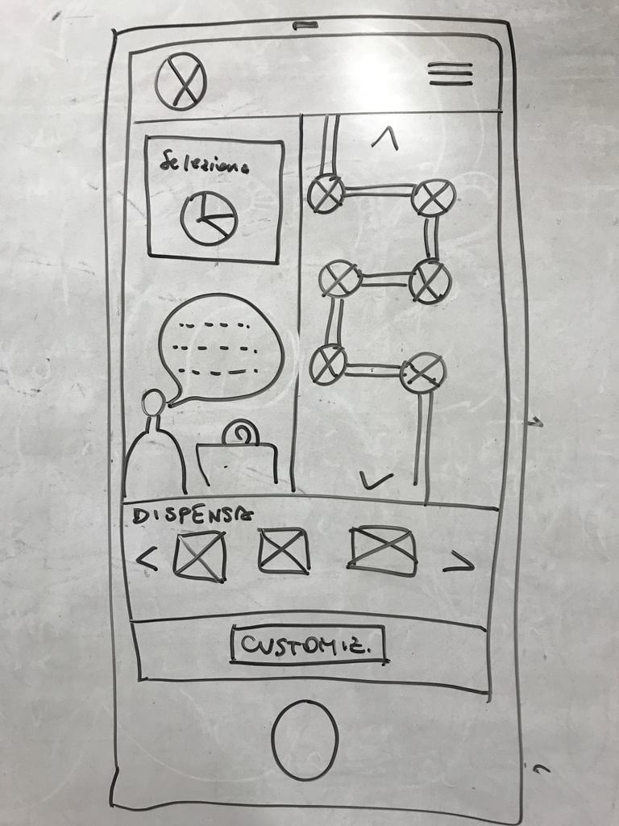
Further Developments
Mobile application too!
Designs
saving a sauce under construction and get back to it later;
for the other sauces interface features
(especially the pipe) and graphic design will be adapted.
System
Functional enrichment with a login system;
users’ profiles and community.

Slide 23
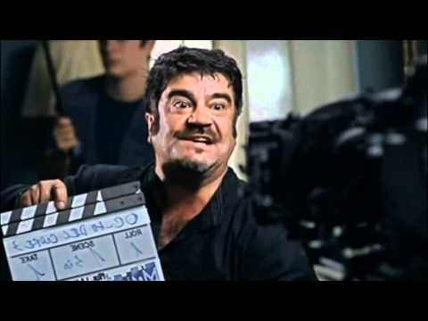
Fin

